Slide 1
e-Commerce Exploratory Data Analysis for a UK-based Online Retail Company
Understanding Business Data

Slide 2
Introduction
This data analysis project focuses on a UK-based non-store online retail company that specializes in selling all-occasion gifts to a customer base consisting primarily of wholesalers, both local and international. The dataset is about over a period of one year, from 1st December 2010 to 9th December 2011.
The primary goal of this analysis is to perform a comprehensive Exploratory Data Analysis (EDA) and derive valuable insights from the data.

Slide 3
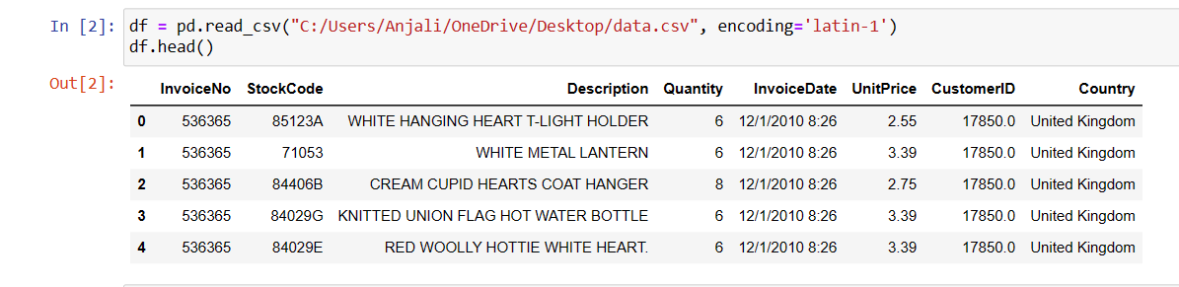
Data overview
Period- 1st Dec 2010 – 9th Dec 2011
Purpose- Analyzing business transactions over one year.

Slide 4
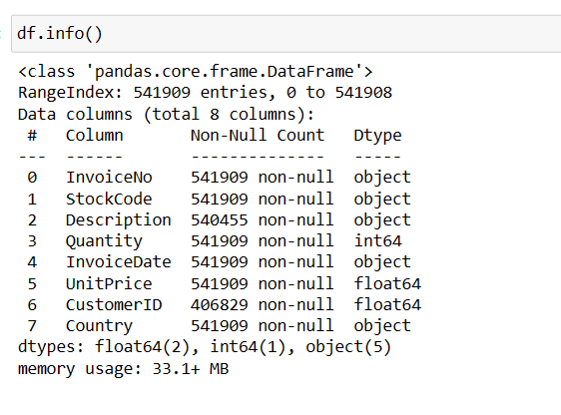

Slide 5
Problem Statements
Perform Basic EDA a. Boxplot –
All Numeric Variables
Histogram – All Numeric Variables
Distribution Plot – All Numeric Variables
Aggregation for all numerical Columns
Unique Values across all columns
Duplicate values across all columns
Correlation – Heatmap - All Numeric Variables
Regression Plot - All Numeric Variables
Bar Plot – Every Categorical Variable vs Every Numerical Variable
Pair plot - All Numeric Variables
Line chart to show the trend of data - All Numeric/Date Variables
Plot the skewness - All Numeric Variables

Slide 6
2. Check for missing values and replace them with appropriate metrics.
3. Remove duplicate rows
4. Remove rows with negative Quantity values
5. Add Month, Day, and Hour columns to the invoice
6. Calculate the number of orders per customer
7. Identify the top 5 customers with the most orders
8. Calculate the total money spent by each customer
9. Find the top 5 customers with the highest spending
10. Analyze the number of orders per month
11. Explore the number of orders per day
12. Investigate the number of orders per hour
13. Examine the number of orders for each country
14. Visualize the trend of orders across months
15. Calculate and visualize the total money spent by customers from each country

Slide 7
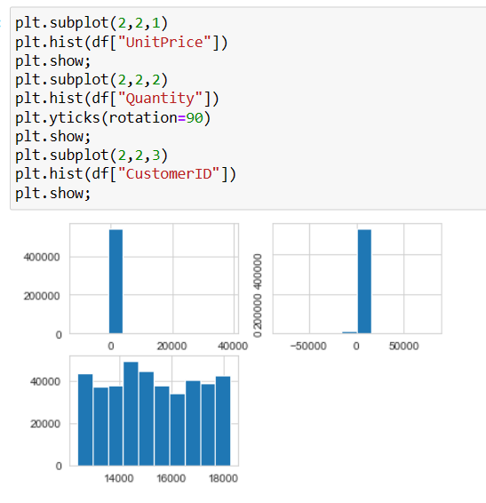
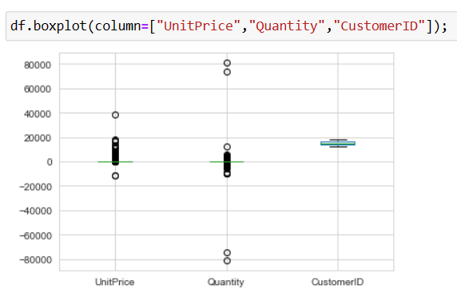
Methodology
Data Exploration and Visualization:
This initial step involves getting to know your dataset. You aim to understand the structure of the data and identify any potential issues.

Slide 8
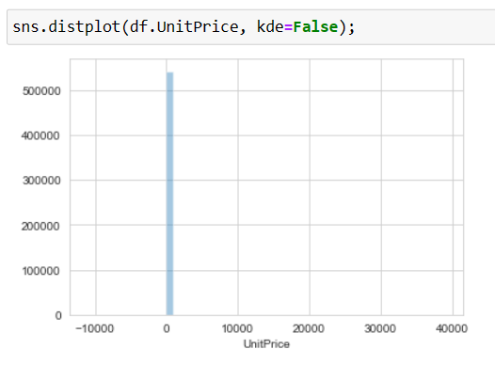
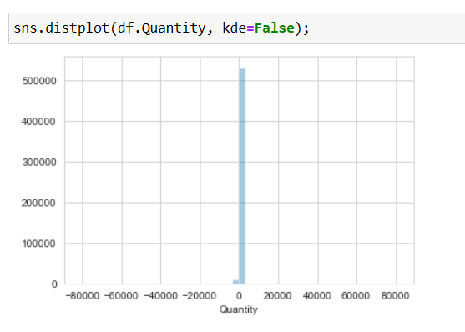
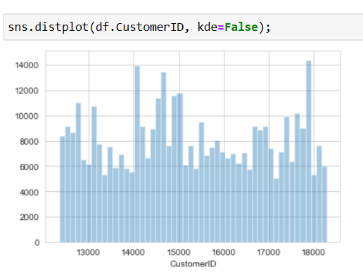

Slide 9
Data Cleaning and Preprocessing:
In this step, the focus is on preparing the data for analysis by addressing any issues identified during data exploration.
Tasks include:
Handling missing data: deciding how to deal with missing values (imputation using mean, median, mode, or removal of incomplete rows).
Removing duplicates: Eliminating duplicate records to avoid bias in analysis.
Handling outliers: Deciding whether to keep, remove, or transform outliers in the data.
Data type conversion: Ensuring that data types are appropriate for analysis.
Feature engineering: Creating new features or transforming existing ones to extract meaningful information.

Slide 10
Statistical Analysis:
After data cleaning, statistical analysis is performed to gain a deeper understanding of the data and uncover patterns and relationships.
Tasks in this stage may include:
Hypothesis testing: Assessing whether there are significant differences or relationships between variables.
Regression analysis: Modeling the relationship between dependent and independent variables.
Time series analysis: Exploring trends and seasonality in time-related data.
Descriptive and inferential statistics: Using various statistical measures to describe and draw inferences from the data.
Statistical analysis helps to validate hypotheses and quantify relationships between variables.

Slide 11
Visualization Techniques:
Data visualization is a crucial part of the analysis, aiding in the interpretation of complex data and the communication of findings.
Techniques include:
Heatmaps: Visualizing correlations between variables.
Scatter plots: Displaying relationships between two numeric variables.
Line charts: Illustrating trends over time.
Bar charts: Comparing categories.
Box plots: Showing the distribution and spread of data.
Choosing the appropriate visualization method depends on the type and purpose of the analysis.

Slide 12
Interpretation and Insights:
After performing data exploration, cleaning, statistical analysis, and visualization, the final step is to draw meaningful conclusions and insights from the data.
This involves:
Synthesizing the findings: Identifying patterns, trends, anomalies, and relationships.
Connecting with the business context: Relating the insights to the business problem and goals.
Formulating actionable recommendations: Suggesting potential actions or decisions based on the insights.
Effective communication of results and insights is key, often through reports, presentations, or visualizations that convey the findings to stakeholders.

Slide 13
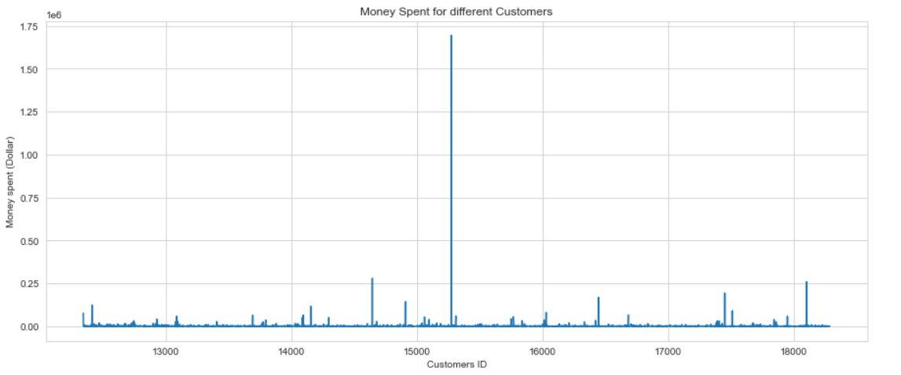
Sample Visualizations

Slide 14
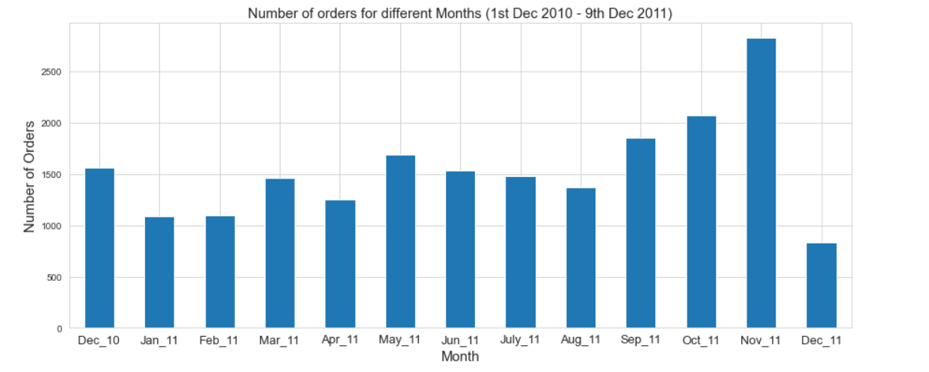

Slide 15
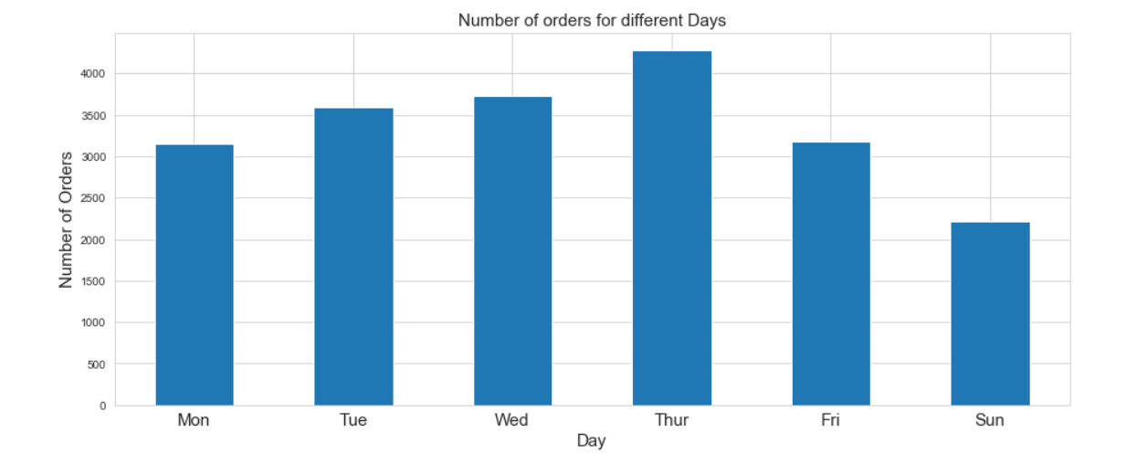

Slide 16
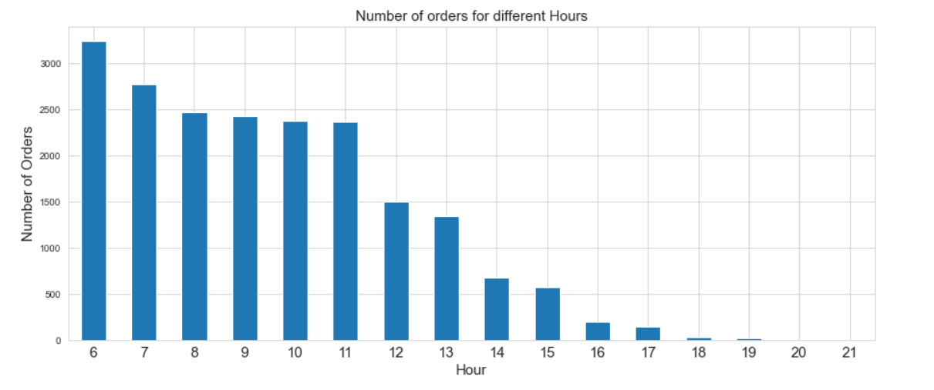

Slide 17
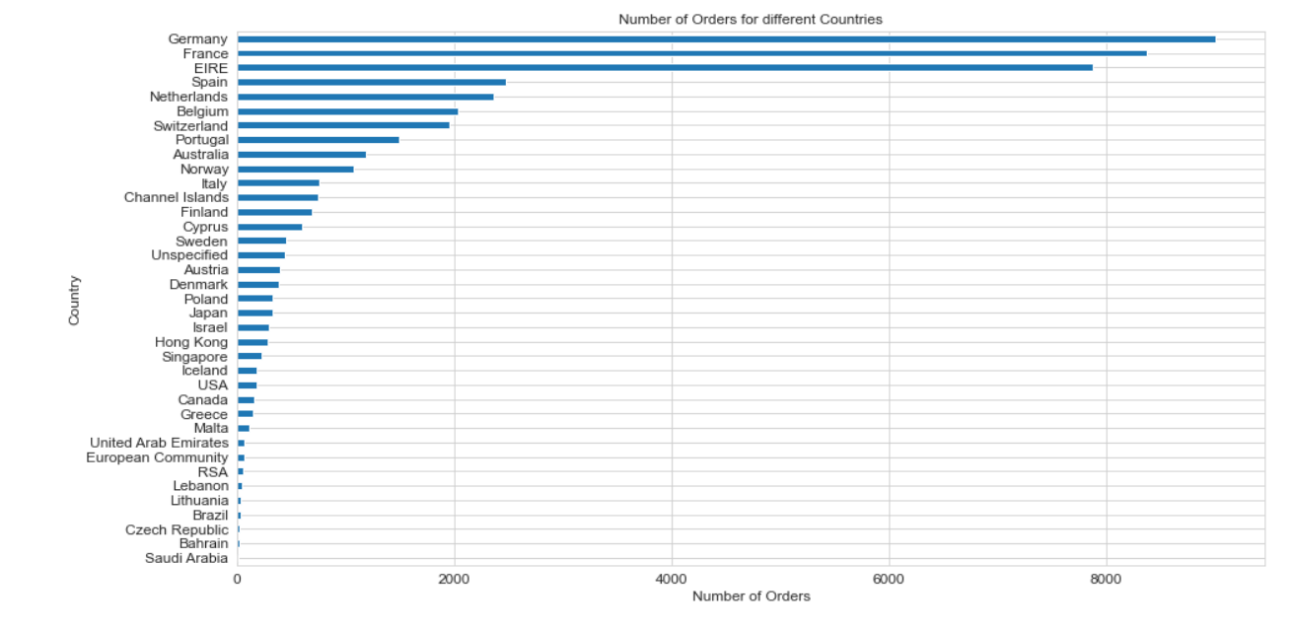

Slide 18
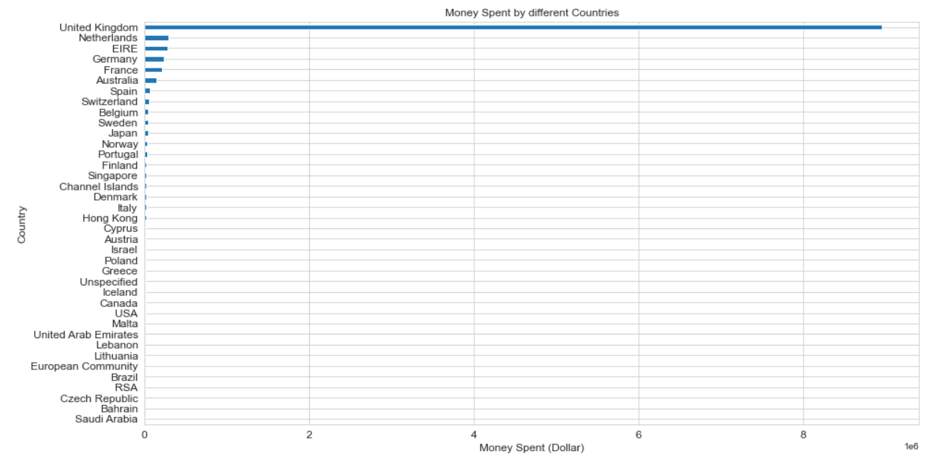

Slide 19
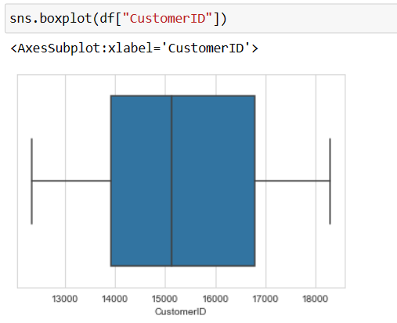
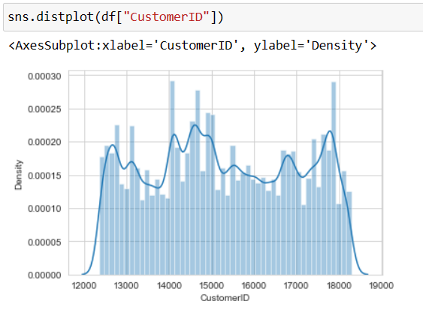
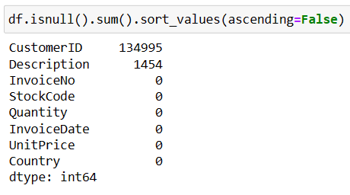
Data Cleaning
Checking for missing values in all columns and replacing them with appropriate metrics.

Slide 20
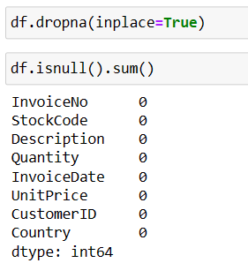
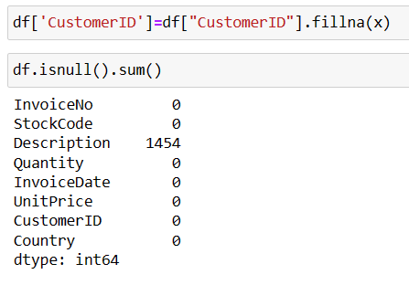
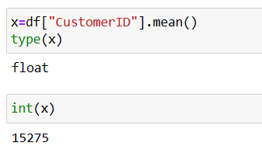

Slide 21
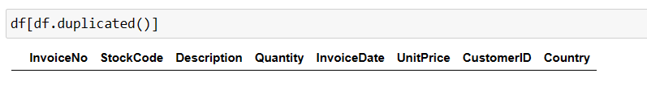
Remove duplicate rows.

Slide 22
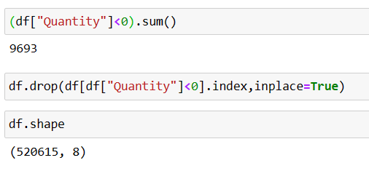
Remove rows that have negative values in the Quantity column.

Slide 23
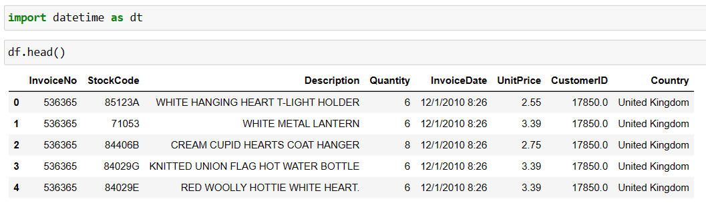
Additional Columns
Add the columns- Month, Day, and Hour for the invoice.

Slide 24
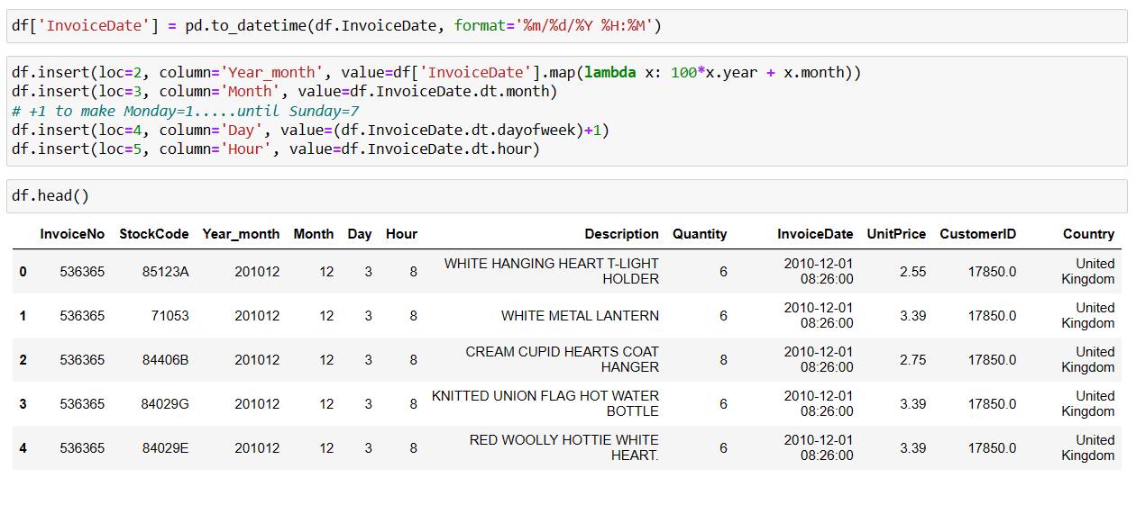

Slide 25
Results
The customer with the highest number of orders comes from the United Kingdom (UK)
The customer with the highest money spent on purchases comes from the Netherlands
The company receives the highest number of orders from customers in the UK (since it is a UK-based company).
Therefore, the TOP 5 countries (including the UK) that place the highest number of orders are as below:
United Kingdom
Germany
France
Ireland (EIRE)
Spain
As the company receives the highest number of orders from customers in the UK (since it is a UK-based company), customers in the UK spend the most on their purchases.

Slide 26
Therefore, the TOP 5 countries (including the UK) that spend the most money on purchases are as below:
United Kingdom
Netherlands
Ireland (EIRE)
Germany
France
November 2011 has the highest sales
The month with the lowest sales is undetermined as the dataset consists of transactions until 9th December 2011 In December
Possibly the store is closed on Saturdays as there are no transactions on Saturday between 1st Dec 2010-9th Dec 2011
The number of orders received by the company tends to increase from Monday to Thursday and decrease afterward.
The company receives the highest number of orders at 12:00 pm
Possibly most customers made purchases during lunch hour between 12:00 pm-2:00 pm.
The company tends to give out FREE items for purchases occasionally each month However, it is not clear what factors contribute to giving out the FREE items to the particular customers

Slide 27
Thank You…

